Slide 1
PARK EASE
Smart Parking Management system

Slide 2
Team members
Priyanka Muralidharan - Backend
Akshaya Venkatesan - Frontend
Nandani Baghel - Backend
Charishma Gangireddy - Frontend

Slide 3
Problem statement
Finding a parking space in crowded areas is difficult and time-consuming. Drivers often spend a lot of time searching for available parking, which leads to traffic congestion, fuel wastage, and inconvenience. Traditional parking systems do not provide real-time information about available slots. Therefore, a smart system is needed to help users easily find and reserve parking spaces.

Slide 4
Proposed Solution
Objectives
Develop a smart parking management system to help users find available parking spaces.
Provide real-time information about parking slot availability.
Allow users to reserve parking spaces in advance through a web application.
Store parking and booking details in a database for efficient management.
Provide a simple and user-friendly interface for easy parking managemen
Reduce time spent searching for parking and minimize traffic congestion.
• Provide real-time parking availability
• Reduce time spent searching for parking
• Improve parking space utilization
• Reduce traffic congestion
• Provide a simple user-friendly system

Slide 5
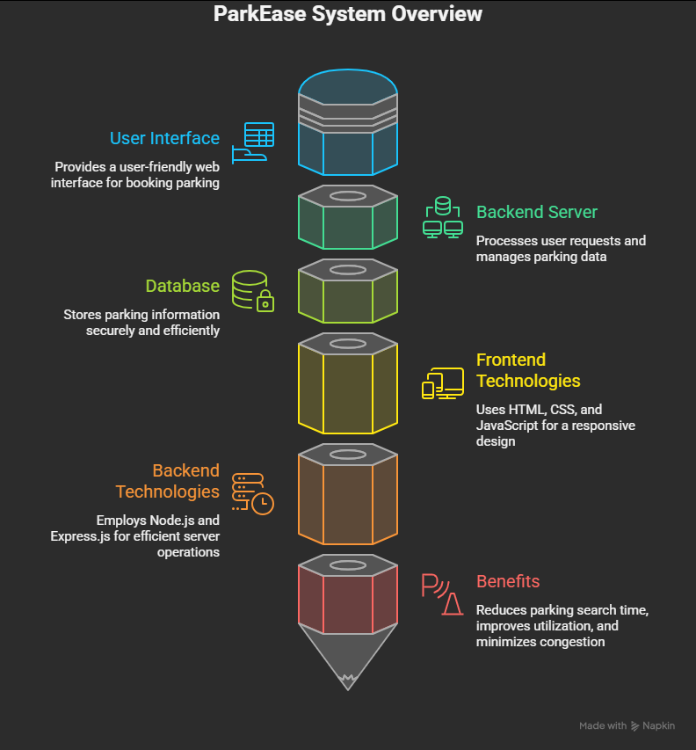

Architecture Diagram

Slide 6
Tech stack
FRONTEND
Html, Css, JavaScript
BACKEND
SpringBoot, Hibernate, JWT Authentication
DATABASE - MySQL
SERVER - Tomcat Apache
PLATFORM - Eclipse, Postman

Slide 7
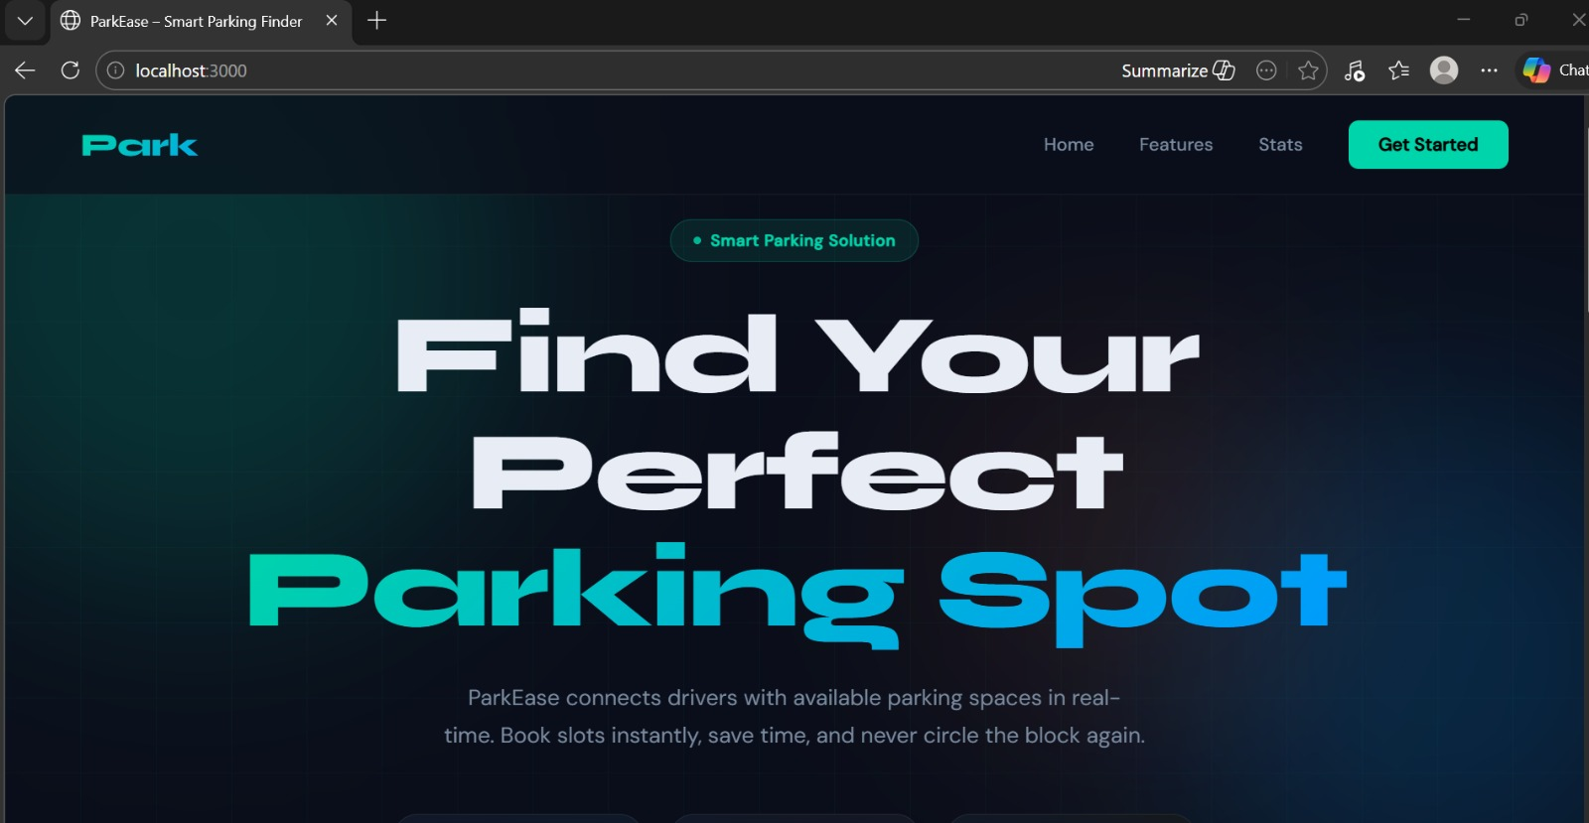
Home PAGE

Slide 8
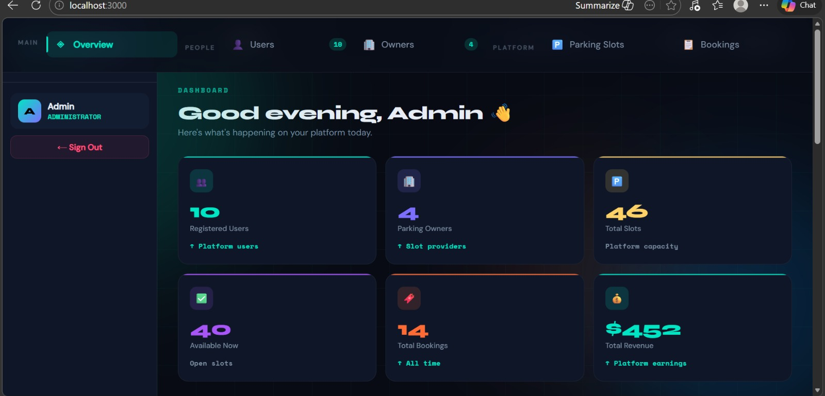
Admin Dashboard

Slide 9
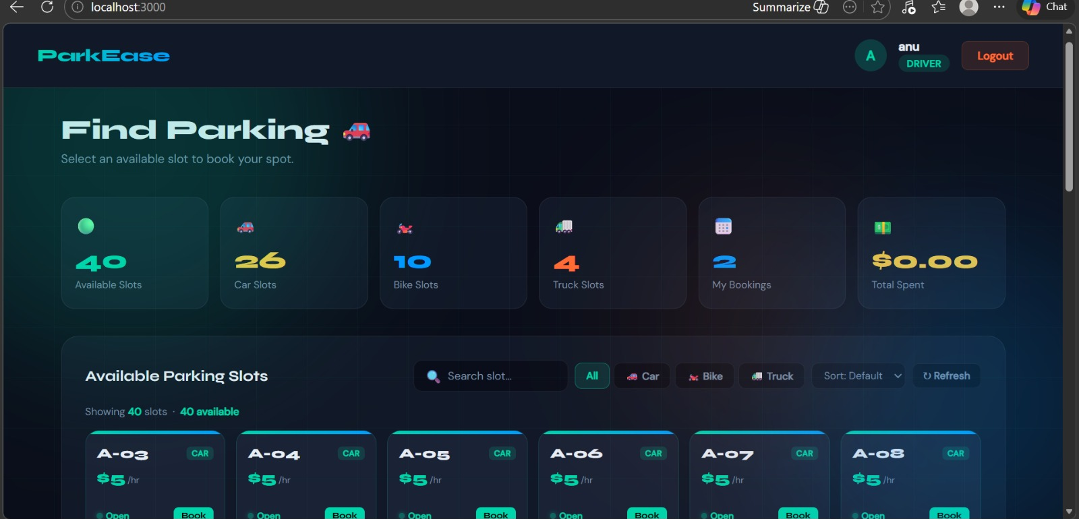
USER dashboard

Slide 10
Key features
Future scope
Real-time parking availability
Parking slot booking
User authentication
Easy navigation
Efficient parking management
Mobile application development
Integration with Google Maps
Online payment system
IoT-based parking sensors for real-time updates
AI-based parking prediction
Automatic vehicle detection system

Slide 11
conclusion
ParkEase provides an efficient solution for modern parking problems by enabling users to find and reserve parking spaces easily. It helps reduce traffic congestion and improves parking management.
THANKYOU

